Slide 1
1.3 Simplifying Expressions and Solving Equations.

Slide 2
Combine Like terms
Simplify
3x+2x=
3x+2y+2x+7y=
3x+5x-2=
14x+y-2x+4y-7=

Slide 3
Parallel
Example 1
Determining Whether a Number is a Solution of an Equation
Is 9 a solution of either one of these equations?
a.
16 = x + 7
b.
3y + 2 = 30
Replace x with 9.
Replace y with 9.
3y + 2 = 30
16 = x + 7
3(9) + 2 = 30
16 = 9 + 7
27 + 2 = 30
16 = 16
True
29 = 30
False
9 is a solution of the equation.
9 is not a solution of the equation.
Slide 9.6- 3

Slide 4
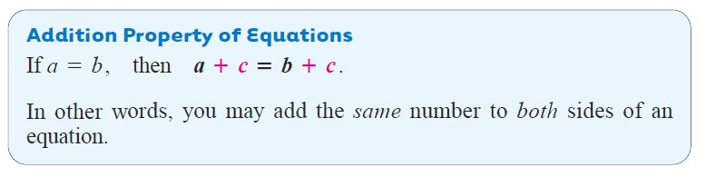
Slide 9.6- 4

Slide 5
Parallel
Example 2
Solving Equations Using the Addition Property
Solve each equation.
a.
m – 13 = 28
m – 13 + 13 = 28 + 13
m + 0 = 41
Check:
m = 41
m – 13 = 28
The solution is 41. To check, replace m with 41 in the original equation.
41 – 13 = 28
28 = 28
The result is true, so 41 is the solution.
Slide 9.6- 5

Slide 6
Parallel
Example 2
continued
Solving Equations Using the Addition Property
Solve each equation.
b.
5 = n + 7
5 + (−7) = n + 7 + (–7)
–2 = n + 0
Check:
–2 = n
5 = n + 7
The solution is −2. To check, replace n with −2 in the original equation.
5 = −2 + 7
5 = 5
The result is true, so −2 is the solution.
Slide 9.6- 6

Slide 7
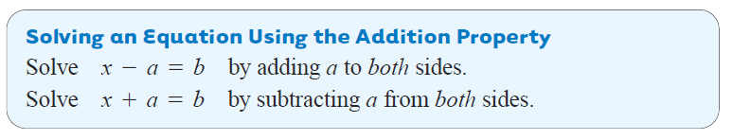
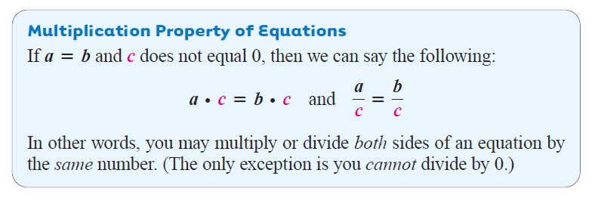
Slide 9.6- 7

Slide 8
Parallel
Example 3
Solving Equations Using the Multiplication Property
Solve each equation.
a.
6k = 54
Divide both sides by 6, to get k by itself.
1
1
Check:
The solution is 9. To check, replace k with 9 in the original equation.
6k = 54
6 ∙ 9 = 54
54 = 54
The result is true, so 9 is the solution.
Slide 9.6- 8

Slide 9
Parallel
Example 3
continued
Solving Equations Using the Multiplication Property
Solve each equation.
b.
−8y = 32
Divide both sides by −8, to get y by itself.
1
1
Check:
−8y = 32
−8(−4) = 32
The solution is −4. To check, replace y with −4 in the original equation.
32 = 32
The result is true, so −4 is the solution.
Slide 9.6- 9

Slide 10
Parallel
Example 4
Solving Equations Using the Multiplication Property
Solve each equation.
a.
Multiply both sides by 5, to get x by itself.
1
1
Check:
The solution is 35. To check, replace x with 35 in the original equation.
The result is true, so 35 is the solution.
Slide 9.6- 10

Slide 11
Parallel
Example 4
continued
Solving Equations Using the Multiplication Property
b.
Multiply both sides by −9/2, to get m by itself.
1
1
2
Check:
1
1
1
−2
The solution is −18. To check, replace m with −18 in the original equation.
1
The result is true, so −18 is the solution.
Slide 9.6- 11

Slide 12
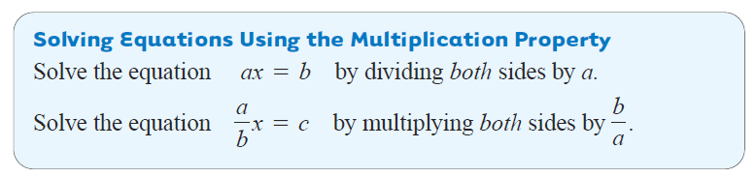
Here is a summary of the rules for using the multiplication property. In these rules, x, is the variable and a, b, and c represent numbers.
Slide 9.6- 12

Slide 13
Solving an Equation with Several Steps
Solve 4w + 2 = 18.
Step 1 Subtract 2 from both sides.
Step 2 Divide both sides by 4.
Step 3 Check the solution.

Slide 14
Solving an Equation with Several Steps
Solve 4w + 2 = 18.
The solution is 4 (not 18).

Slide 15

Examples
$\frac{5}{9}+\frac{3}{4}$
$\frac{7}{2}−\frac{8}{3}$
$\frac{4}{5}+\frac{2}{10}$
$\frac{13}{7}−\frac{9}{5}$
14x=0
$\frac{−2c}{7}=\frac{4}{35}$

Slide 16
Hw Section 1.3 pg 44
1-28

